Slide 1
The app for EVERYTHING
How education comes to life
By Xavier, Zamirul, Kai, Kai Jie
Notes:
Zam

Slide 2

Education
In Singapore, Education is one of the most important industry.
As a Smart Nation, Singapore has succeeded in implementing Online Tools to help with studying
Examples are : McOnline and Student Learning Space (SLS)
Notes:
Singapore has been always been developing their country to become a smart nation, one of the most important industries in Singapore is education, with many governments owned education websites such as McOnline and SLS
Zami dp

Slide 3
Issues
McOnline fails with testing students by exam standards, while SLS struggles with teaching students the required topics
Both websites also do not teach students time management, a skill that will be imperative in the future for them
How can we solve them?
What about the teachers?
Why is it only students who benefits from the Smart Nation Act? Not only marking, teachers also have to console students, deal with parents, and manage school projects.
HENCE THE QUESTION
Notes:
However with every innovations , flaws are absolute

Slide 4
OUR SOLUTION
STUDENTS
TEACHERS
Make learning engaging
Allow students to test themselves
EduBuddy
Assist in marking papers
Create reminders for students

Slide 5
Engaging lessons + Exam standard test
EduBuddy
01
02
Combination of games and quizzes that can gauge student progress
McOnline
SLS
03
Excels in teaching through games
Great way for teachers to see the students understanding
Notes:
When talking about McOnline
Games overall can help students increase motivation. As such, combining lessons with games will serve as a great way for students to stay engaged even while learning boring topics.
As such, we can integrate games into learning via interactive minigames to allow students to learn in an engaging manner as student will be more focused.
Xavier will do

Slide 6

Automated Calendars
We will expand the calendar functions in our app
Automate school and public holidays
Allow students to highlight important dates such as exam periods
Notes:
Kai Kai

Slide 7
Where can AI help?
Teaching students
Marking Papers
Others
50%
30%
20%
AI’s do not have feelings
Cannot relate if students struggles
Possible because answers are ‘fix’
The remaining work is too diverse for AI to help
Notes:
Kai Kai

Slide 8
Where can AI help?
Marking Papers
By giving the AI the answer key, AI can look at student’s answer and see if it is similar to the teacher’s answer
Can also make the AI look out for specific word should the answer require so
30%
Possible because answers are ‘fix’
Notes:
Kai Kai

Slide 9
The Finalise Product

Slide 10
Git Repository

Slide 11

Our App
Paste final link here
Notes:
Shows the UI of the app

Slide 12
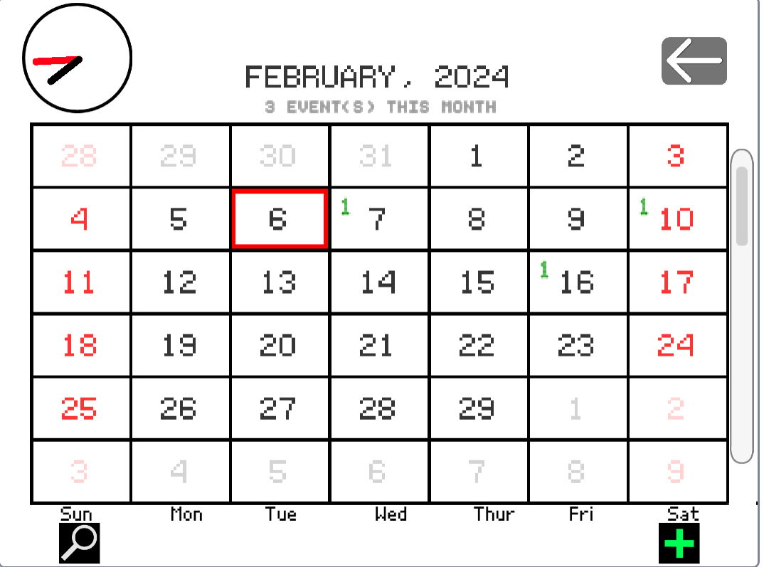
Our Calendar Function

Slide 13
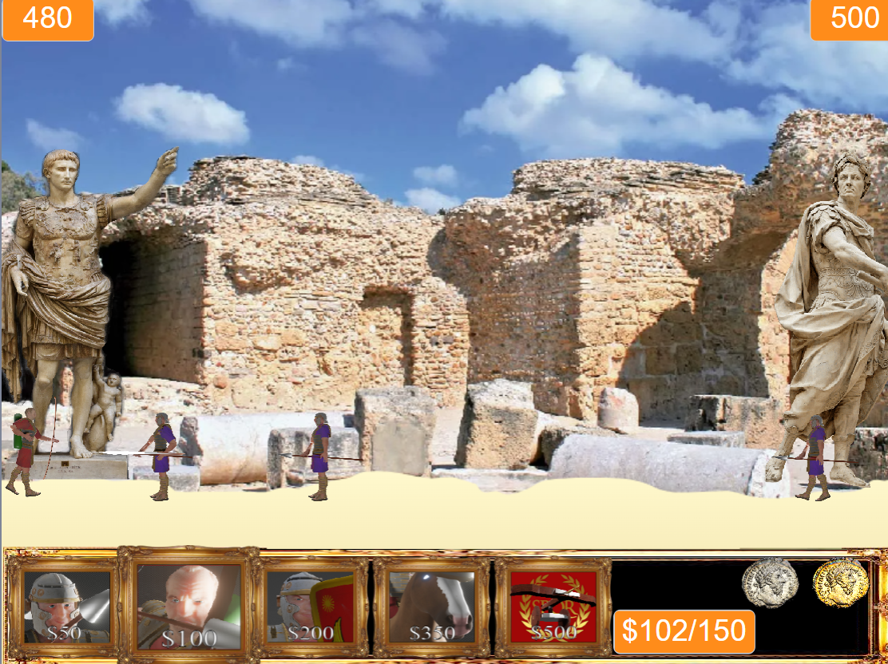
Our History Game
War on Earth Rome

Slide 14

Our Biology Game
Cell Games

Slide 15

Our Math Game
Arithmetic Asteroids

Slide 16
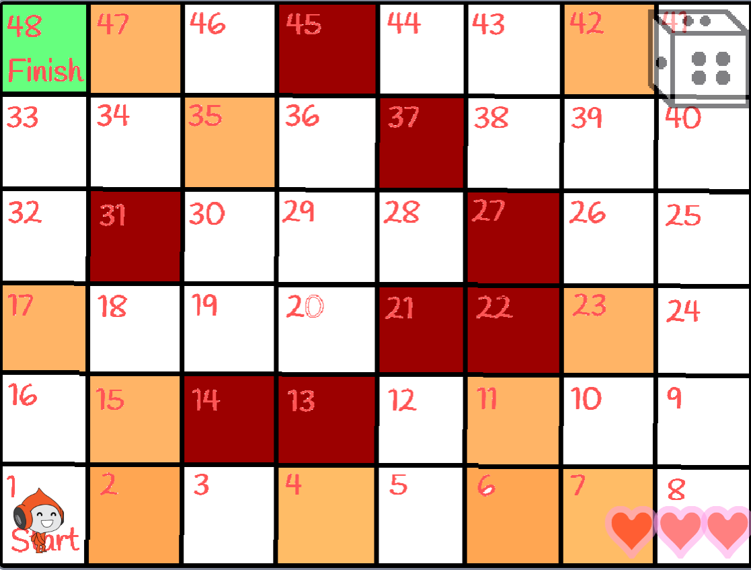
Our English Game
Grammar Impact

Slide 17

AI-powered answer machine

Slide 18
Our Future Plans
Integration of Actual AI into such EduGames
Create an Open Source Edugame platform

Slide 19
Thank You
QUESTIONS?

